Slide 1


Tech Gadgets Failures : A Data Analysis and Visualization Project
Presented By :
Mohammed Danish Y
Data Science & Machine Learning.

Slide 2

Presentation Map :
Introduction to Tech Gadget Failures Dataset
Objectives
Data Overview
Dataset
Using Library For the Data Analysis
Using Functions For the Data Analysis
Data Cleaning Process
Data Visualization Examples
Conclusion
Key-Takeaways

Slide 3
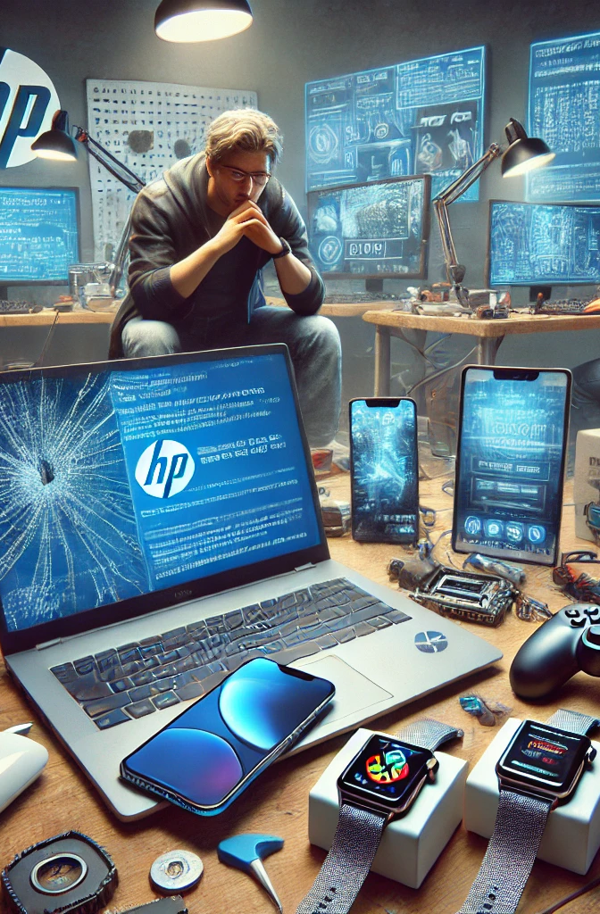
Introduction to Tech Gadget Failures Dataset
In today’s fast-paced digital world, tech gadgets such as smartphones, laptops, smartwatches, and gaming consoles are an essential part of our daily lives. However, with increased usage, these devices are prone to failures, ranging from battery issues and screen cracks to overheating and hardware malfunctions.
This analysis is based on a comprehensive dataset of tech gadget failures, capturing key aspects such as: ✔ Device Type & Brand – Identifying which gadgets and brands face the most failures. ✔ Usage Duration – Understanding how long a device typically lasts before failing. ✔ Failure Types – Categorizing the most common issues faced by users. ✔ Warranty Impact – Analyzing whether devices under warranty fail less often. ✔ Repair Costs & Customer Satisfaction – Examining the relationship between repair expenses and customer ratings.
By leveraging data-driven insights, this study aims to uncover trends in gadget failures, helping manufacturers, repair services, and consumers make informed decisions.
Data source :
https://www.kaggle.com/datasets/danishy/tech-gadget-failures-dataset

Slide 4
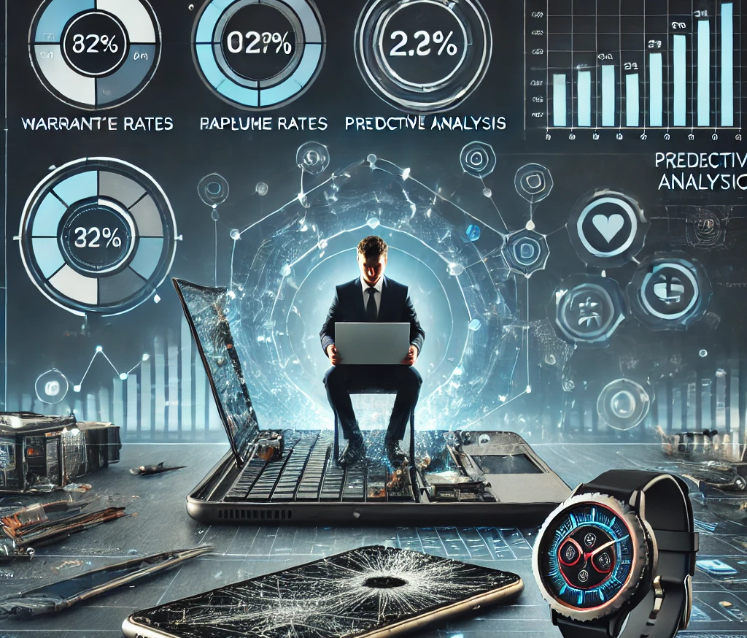
Objectives :
Basic Understanding
Numerical Analysis
Categorical Analysis
Customer Satisfaction & Insights

Slide 5

Basic Understanding :
1.How many missing values are present in each column?
2.What are the top 5 most frequently reported Failure_Type values?
3.What is the distribution of Device_Type in the dataset?
4.Which Brand has the highest number of reported failures?
5.What percentage of failures occurred while the device was under warranty (Warranty_Status = Yes)?

Slide 6
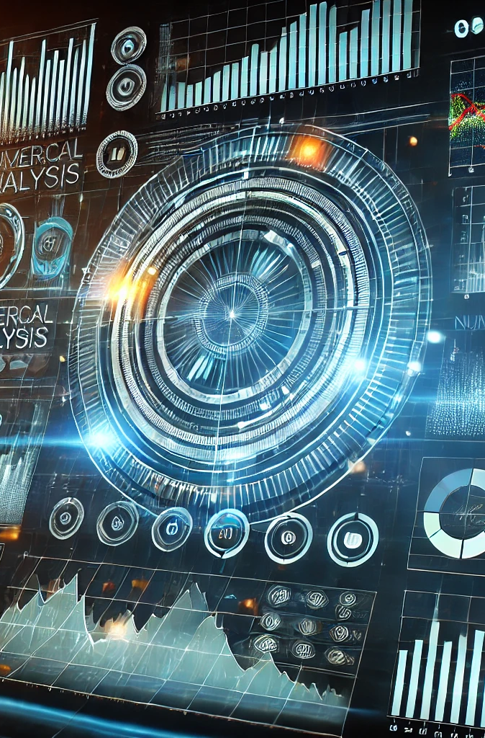
Numerical Analysis :
1.What is the average Usage_Duration before a device fails?
2.What is the distribution of Repair_Cost across different Device_Type values?
3.Which Brand has the highest average Repair_Cost?
4.What is the relationship between Usage_Duration and Repair_Cost?
5.Are there any outliers in the Repair_Cost column?

Slide 7
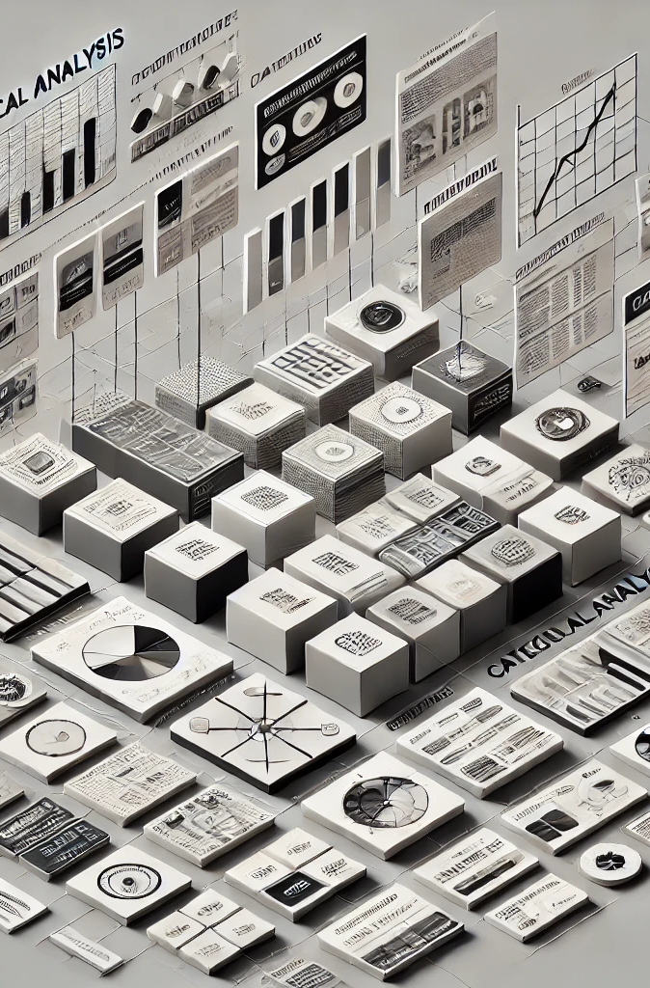
Categorical Analysis :
1.Which Device_Type has the highest failure rate?
2.What are the most common failure types for each Device_Type?
3.What is the most frequent Failure_Type for devices under warranty?
4.Does Warranty_Status affect the likelihood of a high Repair_Cost?
5.Which failure type is most common among the top 3 most expensive repairs?

Slide 8

Customer Satisfaction & Insights :
1.What is the distribution of Customer_Rating? Are there more positive or negative ratings?
2.Which Brand has the best average Customer_Rating post-repair?
3.Create a word cloud from the Comments column to highlight frequently occurring words in customer feedback.

Slide 9
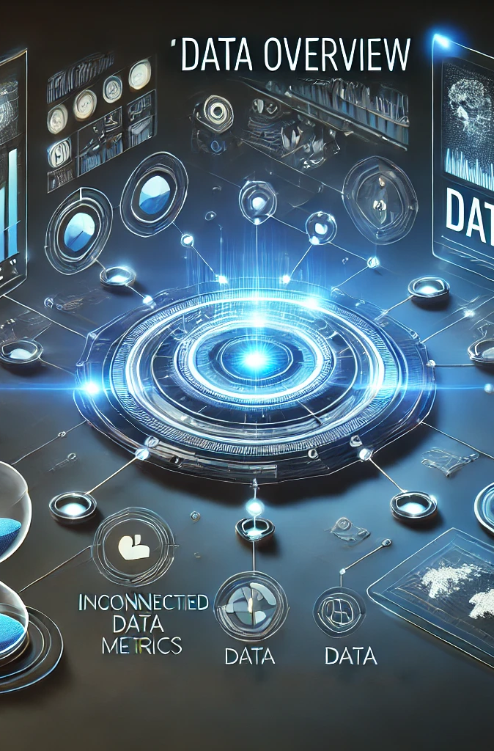
Data Overview :
Failure_ID :- (String)Unique identifier for each failure report
Device_Type :- (Categorical)Type of device (Smartphone, Laptop, Smartwatch, etc.)
Brand :- (Categorical)Brand name (Apple, Samsung, Dell, HP, etc.)
Model_Name :-(String)Model of the device
Usage_Duration :-(Integer)Number of months used before failure
Failure_Type :-(Categorical)Type of failure (Battery Issue, Screen Crack, Overheating, etc.)
Warranty_Status :- (Boolean)Whether the device was under warranty (Yes/No)
Repair_Cost :- (Float)Estimated cost to repair the device
Customer_Rating :- (Float)Rating given by customer post-repair (1-5)
Comments :- (Text)Customer's feedback about the failure experience.

Slide 10

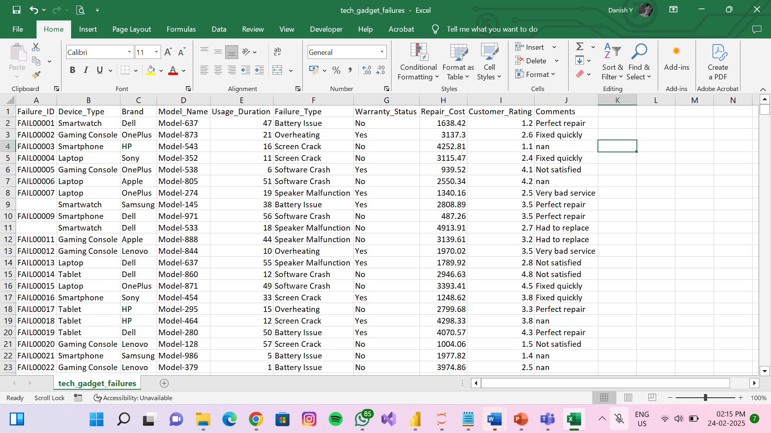
Dataset :

Slide 11

Using Libraries for data analysis :
NumPy: NumPy is a Python library used for working with numbers and arrays. It helps in performing fast mathematical operations like addition, multiplication, and statistics on large datasets.
2. Pandas: Pandas is a Python library used for working with data. It helps in organizing, analyzing, and manipulating data efficiently, especially in tables (Data Frames) like an Excel sheet.
3. Matplotlib: It is used for the Visualization. It’s a versatile library for generating various types of plots.
4. Seaborn: Seaborn is used to visual the complex
statistical visualizations .Seaborn is built on top of Matplotlib and simplifies the process of creating informative visualizations.

Slide 12

Using Functions for data analysis :
Value_Counts() is a simple way to count the occurrences of each unique value in a column of a pandas DataFrame or Series.
groupby() in pandas is used to group data based on a column and then perform operations like sum, mean, count, etc., on each group.
sort_values() in pandas is used to sort a DataFrame or Series based on values in ascending or descending order.
corr() in pandas calculates the correlation between numerical columns in a DataFrame. Correlation shows how strongly two variables are related.

Slide 13

Data Cleaning Process :
Reading the Data
Understanding the Data/ Getting some domain knowledge on Data
Replacing junk Values using NaN values
converting each and every column to its respective datatype
Replacing NaN values with some meaningful values
Droping unwanted columns, duplicated columns and duplicated rows
Saving the pure/cleaned dataset in the desirable format

Slide 14
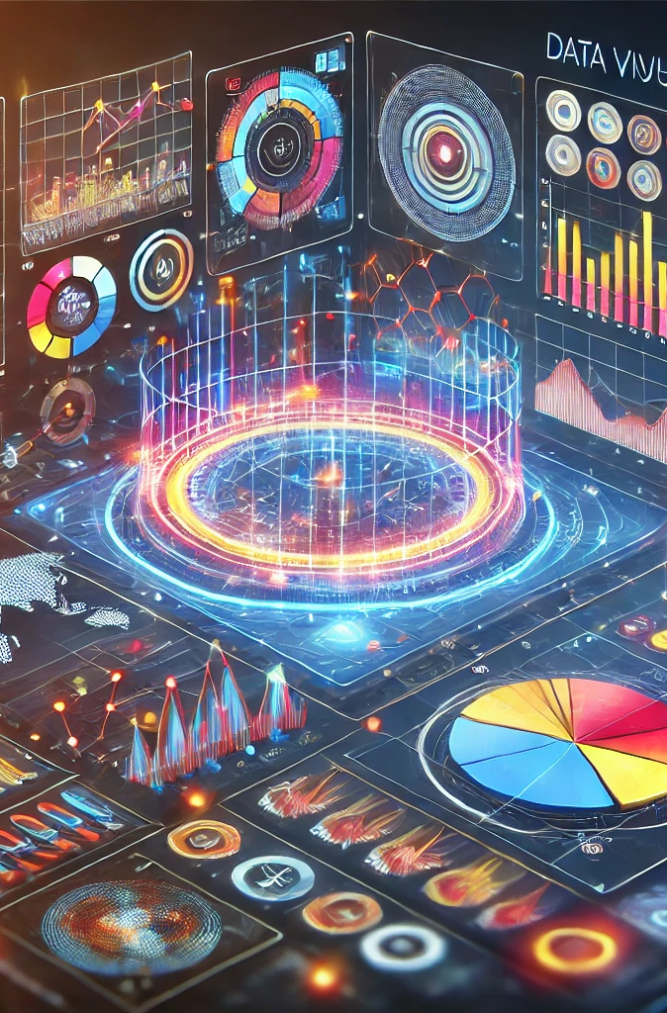
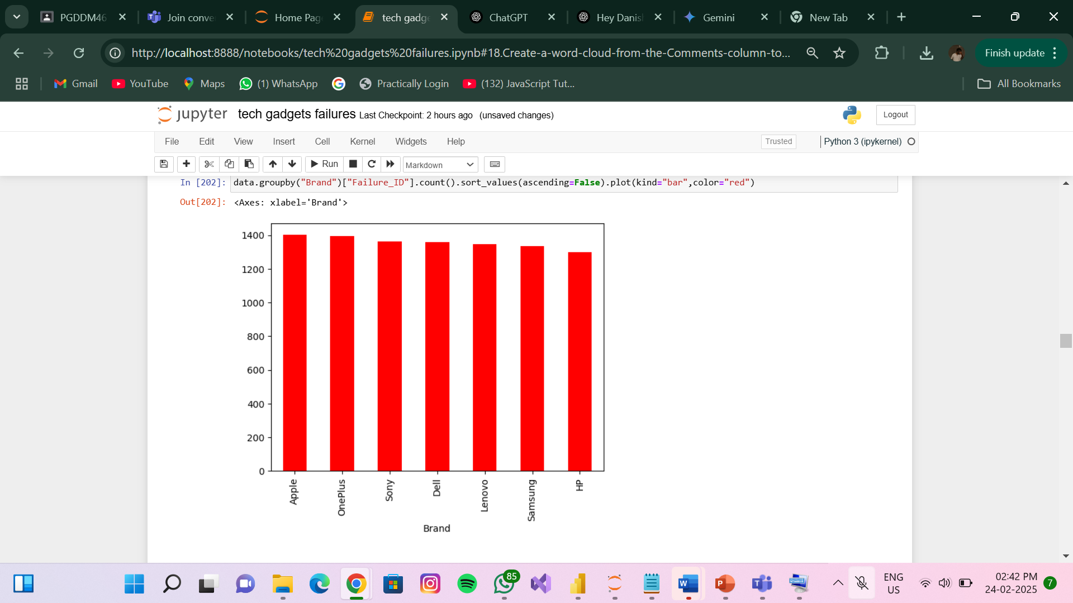
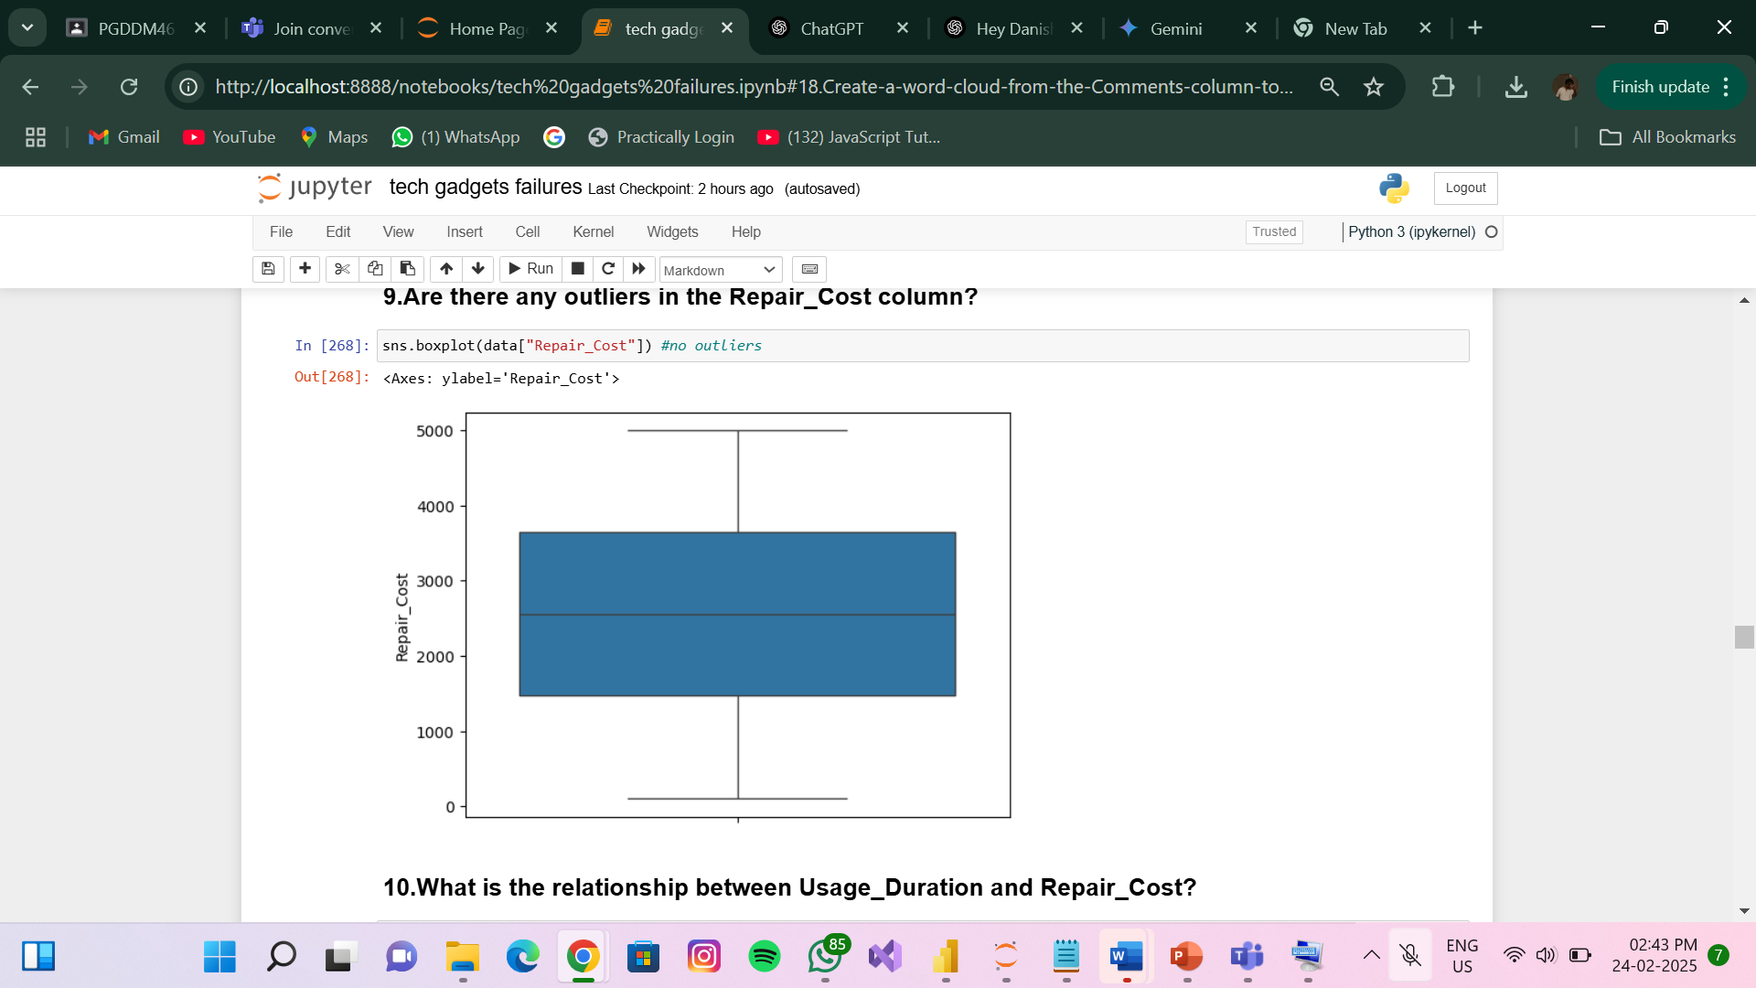
Data Visualization Example :
Box Plot
Bar Plot

Slide 15
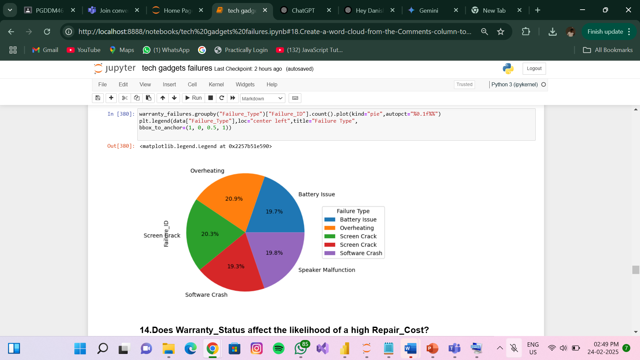
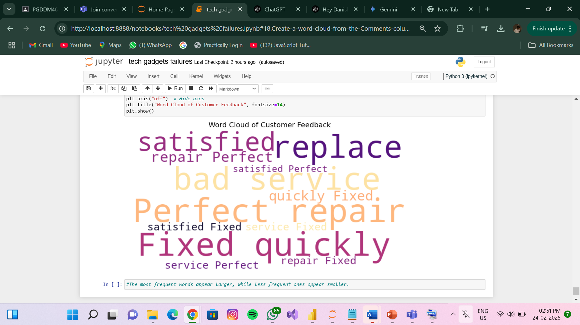
Data Visualization Example :
Word Cloud
Pie Chart

Slide 16

Conclusion :
The Tech Gadget Failures Analysis project provides valuable insights into the common failure patterns of electronic devices. By analyzing factors such as device type, brand, failure type, warranty status, and repair costs, we identified key trends that impact gadget reliability.

Slide 17
Key Takeaways from the analysis include :
Certain device types (e.g., Gaming Consoles and Tablets) had higher failure rates.
Brands varied in repair costs, with some being more expensive to fix.
Warranty status influenced repair expenses, with out-of-warranty repairs costing significantly more.
Customer feedback analysis highlighted recurring issues and satisfaction levels.
By leveraging data visualization, numerical & categorical analysis, this project demonstrates how data-driven decisions can help manufacturers improve product quality and customer experience.

Slide 18

Thank You
Mohammed Danish Y
danishy718@gmail.com

